Slide 1
Multi Threading and Multi Threading Models in OS
By Sahil Deo

Slide 2
Table of Contents
Sr. No. | Content
1 | What is a Thread?
2 | Single Threading vs Multi Threading
3 | Advantages of Multi Threading
4 | Types of Threads
5 | Multi Threading Models
6 | Recap of the slideshow

Slide 3
What is a Thread?
A Thread is a basic unit of CPU utilization.
Program
Process
Thread

Slide 4

Example of Processes of a Program

Slide 5
Single Thread vs Multiple Threads in a Process
Single Threaded Process
Multi Threaded Process
Files
Data
Files
Data
Thread Properties
Properties
Properties
Properties
Thread

Slide 6
Advantages of Multi Threaded Processes over Single Threaded Processes
The Process will continue to run even if one of its thread is blocked.
Creating a new process for each new task is CPU extensive, instead just another light weight thread can be made for it.
Resources are easily shared between different Threads.

Slide 7
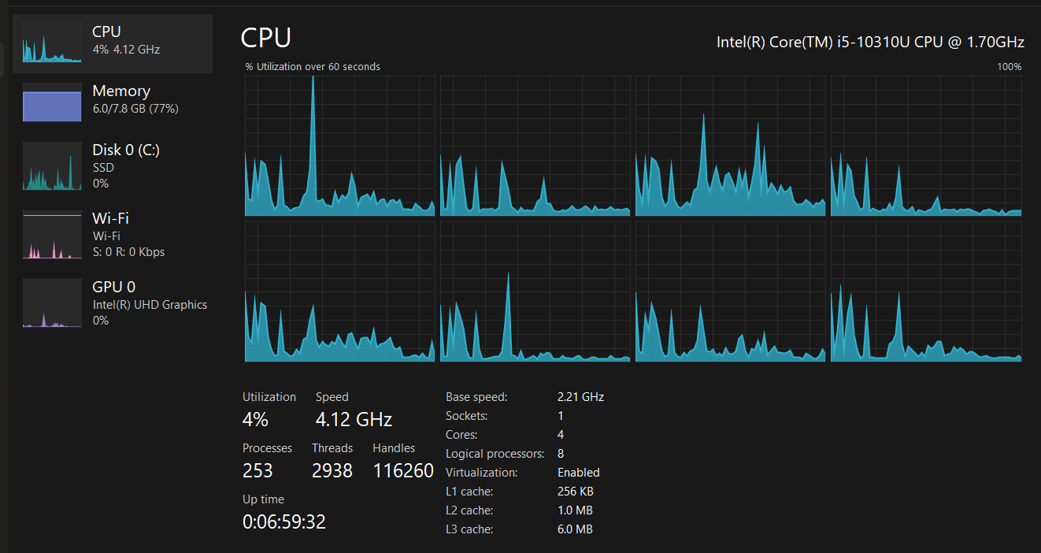
Example of simultaneous Processes and Threads in a System

Slide 8
Types of Threads in an OS
Threads
User Threads
Kernel Threads
Users threads are thread implementation
for user mode
Kernel threads are thread implementation
for kernel mode

Slide 9
Multi Threading Models in OS
Multi Threading models are different architecture that are used to connect User Threads and Kernel Thread.
One to Many
One to One
Many to Many

Slide 10
One to Many Model
Kernel Thread
One Kernel Thread is connected to many User Threads in a Process
Advantages:
Only one Kernel Thread is required for the entire Process.
The Thread management is done on the user side so the user have more control over the threads.
Disadvantages:
Since there is only one kernel thread, if one of the user thread is blocking it, then all the other user thread would not be able to access the kernel thread.
Hence, even if there are multiple threads, multithreading tasks would not be able to execute.
User Threads

Slide 11
One to One Model
Kernel Threads
Every User Thread is connected to a Kernel Thread
Disadvantages:
Creating a user thread requires creating creating a corresponding kernel thread.
As the number of user threads grow, a very large number of kernel thread would also be made which is generally restricted on a system.
Advantages:
Even if an User Thread is blocking a Kernel Thread, each user thread will have a free Kernel Thread.
Multiple threads are simultaneously able to run on multiprocessors.
User Threads

Slide 12
One to One Model
Kernel Threads
Every User Thread is connected to every Kernel Thread, where the number if Kernel Threads would be equal to or less than User Threads.
Advantages:
Even if an User Thread is blocking a Kernel Thread, there would be other kernel threads which would be open
This Model overcomes the disadvantages of all the other models.
User Threads

Slide 13
Recap of the Slideshow
What is a Thread?
A Thread is a basic unit of CPU Utilization.
It is responsible for carrying out tasks in a process.
What are the advantages of multi threaded processes over single threaded processes?
The Process will continue to run even if one of its thread is blocked.
Creating a new process for each new task is CPU extensive, instead just another light weight thread can be made for it.
Resources are easily shared between different Threads.
What are the different types of Threads in an OS?
1. User Threads.
2. Kernel Threads.
What are the different models of multi threading?
1. One to Many
2. One to One
3. Many to Many

